Slide 1
Introduction to Big Data Systems
Lecture 6. In Memory Computing(Internals)
Wenguang CHEN
Tsinghua University

Slide 2
Spark Implementation

Slide 3
Agenda
Spark partitions and DAGS
Shuffle in Spark
Reuse of RDD

Slide 4


Spark's architecture
Master-worker-style distributed computation
Driver and executors communicate using RPC
Executors can be arbitrarily added/removed
Driver runs user program, which can be:
Scala REPL (spark-shell)
Pre-compiled jar file (spark-submit)
Driver
Executor
Executor
Executor
Executor
Executor
User Program
Spark Context
Executor
Executor Backend
Block Manager

Slide 5
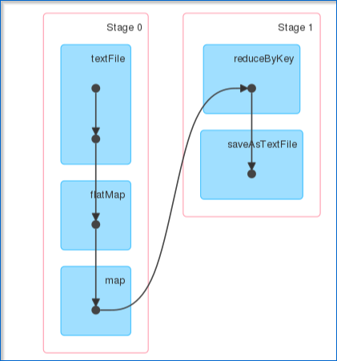
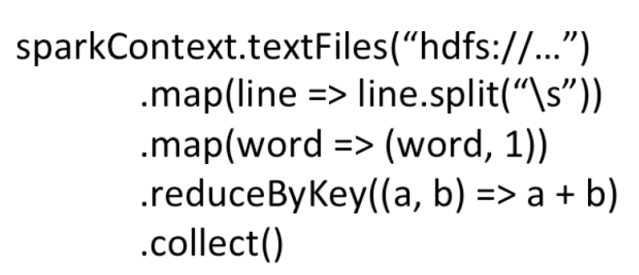
Programs represented by DAGs

Slide 6
RDD implementation: partition
Spark implements RDD as an array that is divided into partitions
val seq = sc.parallelize(1 to 9, 4)
0th element of RDD seq
1
2
partition 0 of RDD seq
RDD seq
partition 1
3
4
partition 2
5
6
partition 3
7
8
9

Slide 7
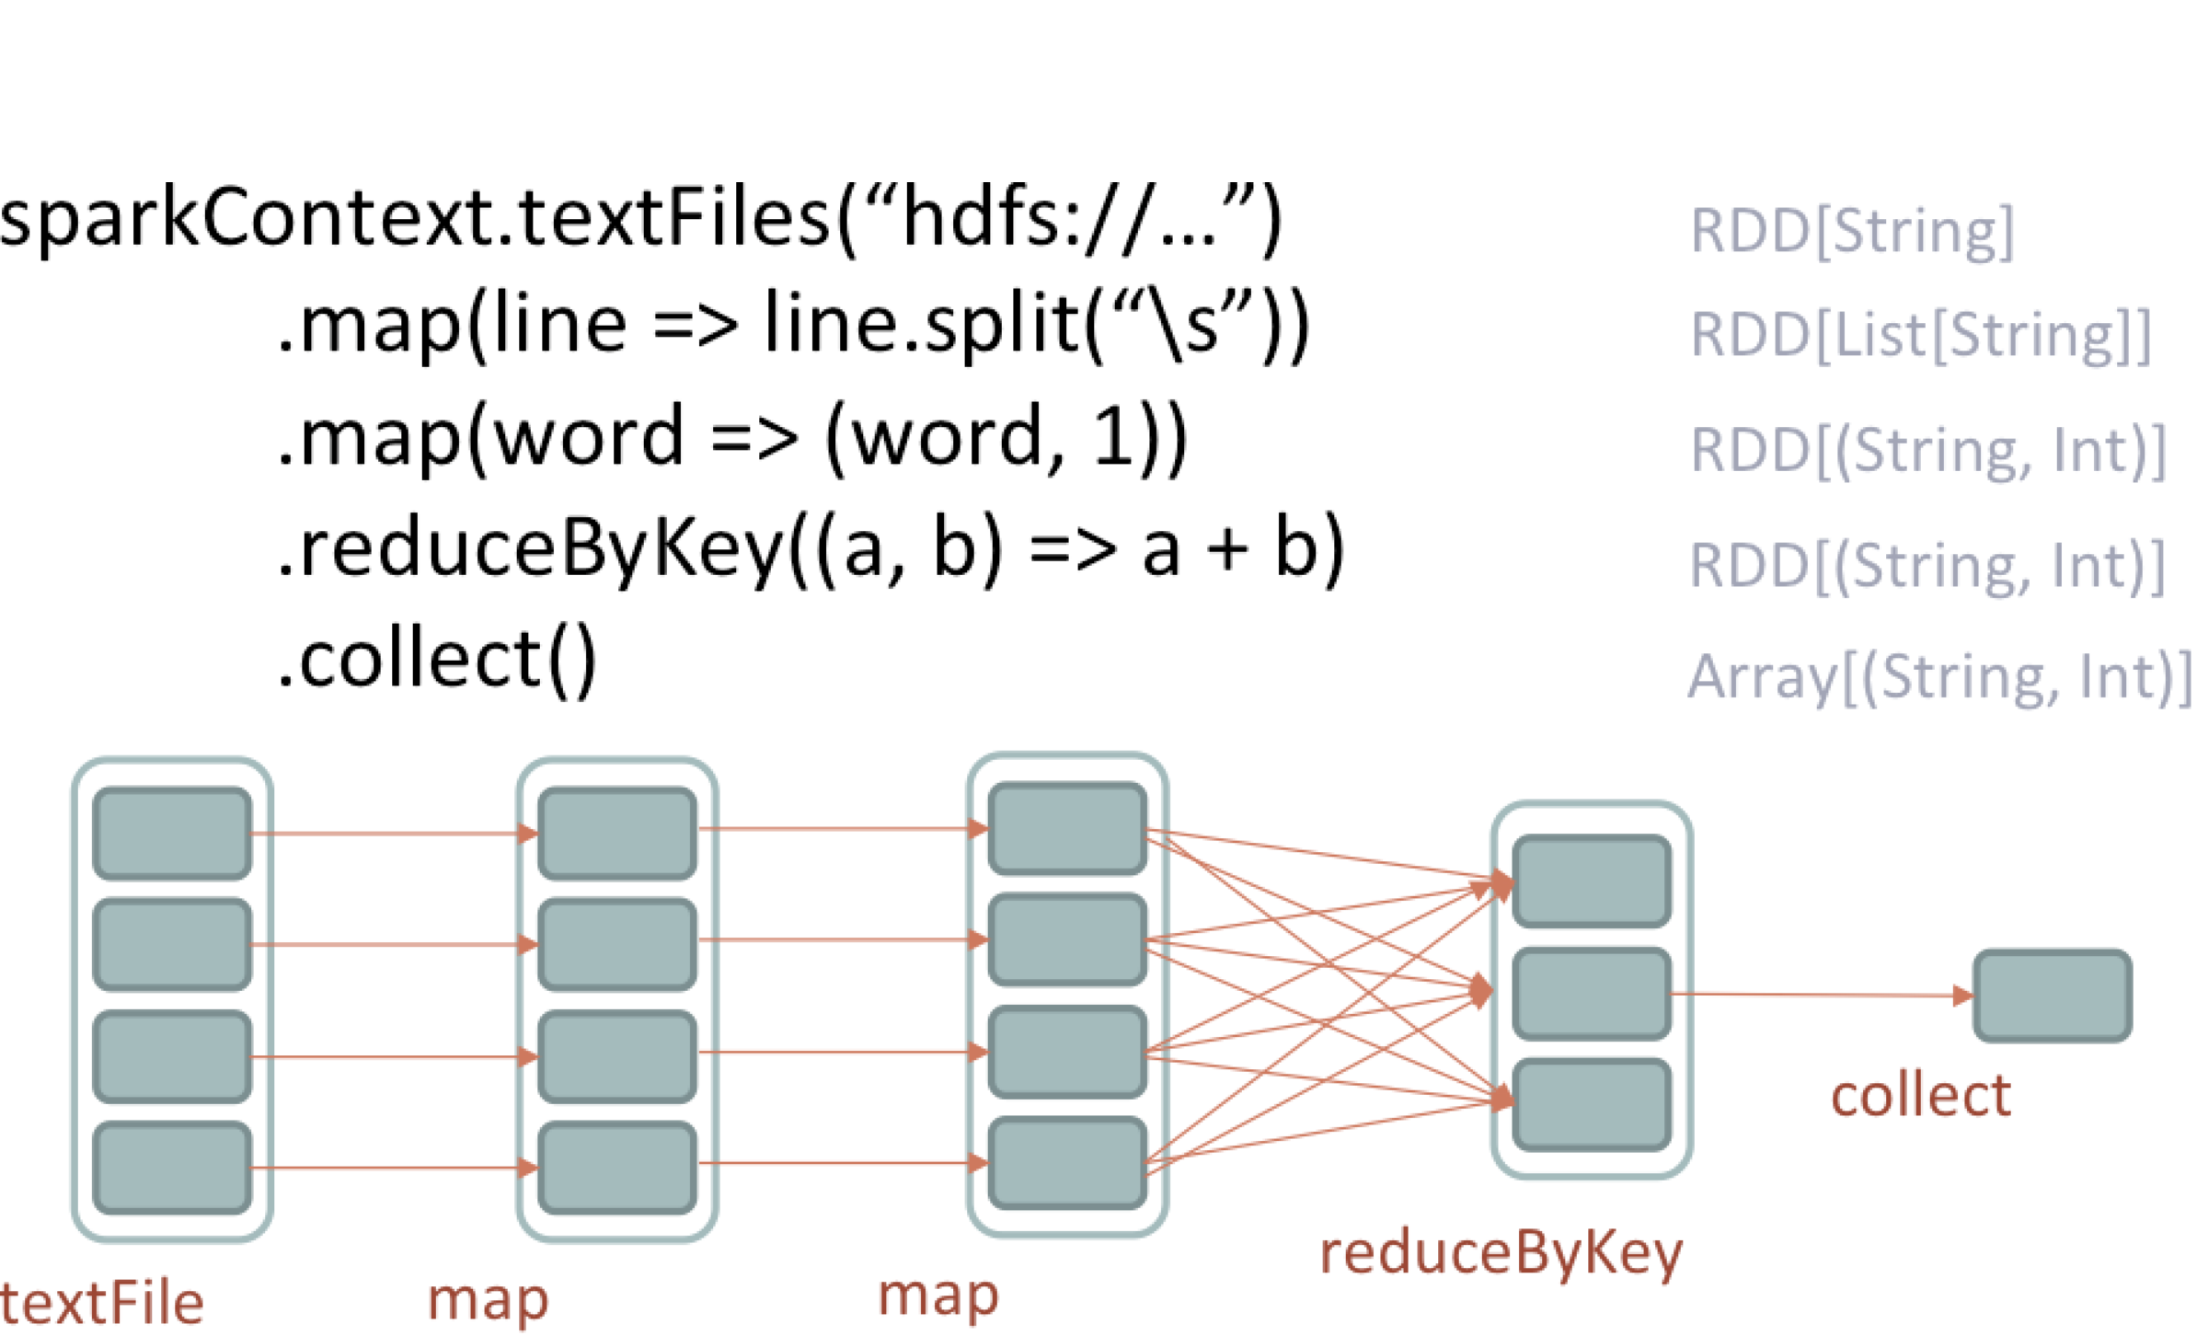
WordCount DAG(Partitioned RDDs)
Action "collect" starts a new job
and a DAG is generated

Slide 8
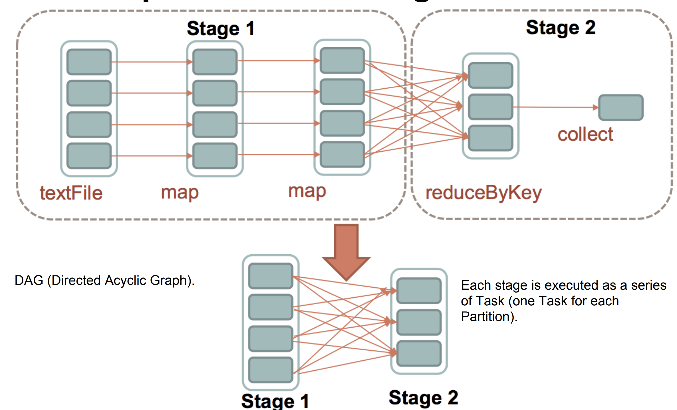
Stages in Spark
The DAG is separated into stages by data shuffling.

Slide 9
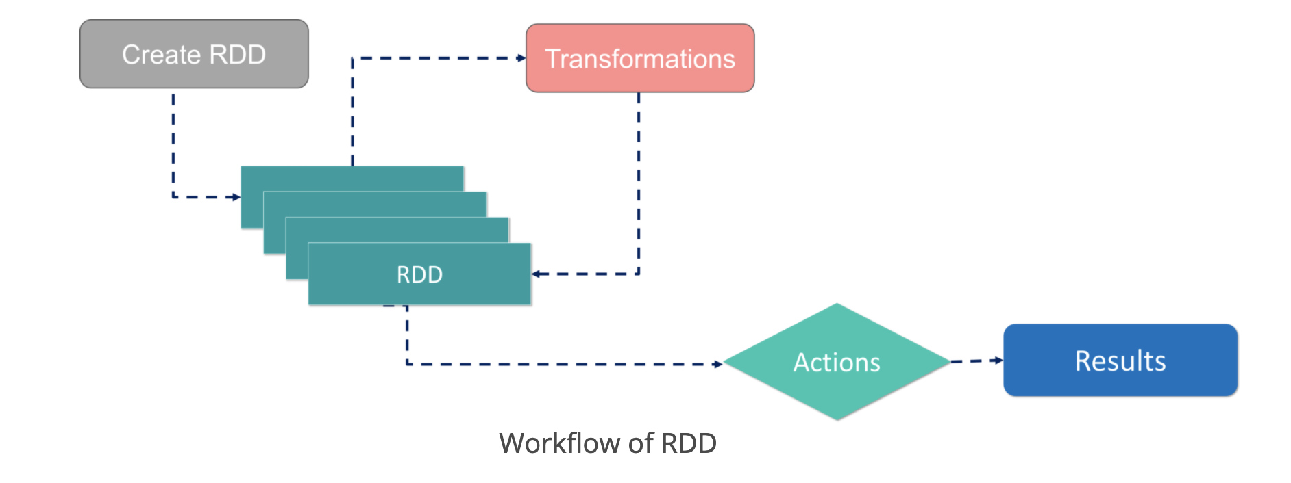
How Spark evaluates RDD?
Three level execution
Each action starts a new job
Each job is defined by a DAG of stages
Each stage contains multiple tasks
Driver dynamically schedules pending tasks to executors
https://www.edureka.co/blog/spark-architecture/

Slide 10
Rationale behind partition and lazy eval
Lazy evaluation enables efficient fault tolerance
RDD's lineage-based fault tolerance, that log the sequences to generate RDD.
Lazy evaluation enables logging the sequences.
Partition balances the failure recovery overhead
When an RDD partition is lost, re-compute the RDD partition.
It recomputes only the lost data.
Its recovery control overhead is small (elements are batched into partitions).

Slide 11
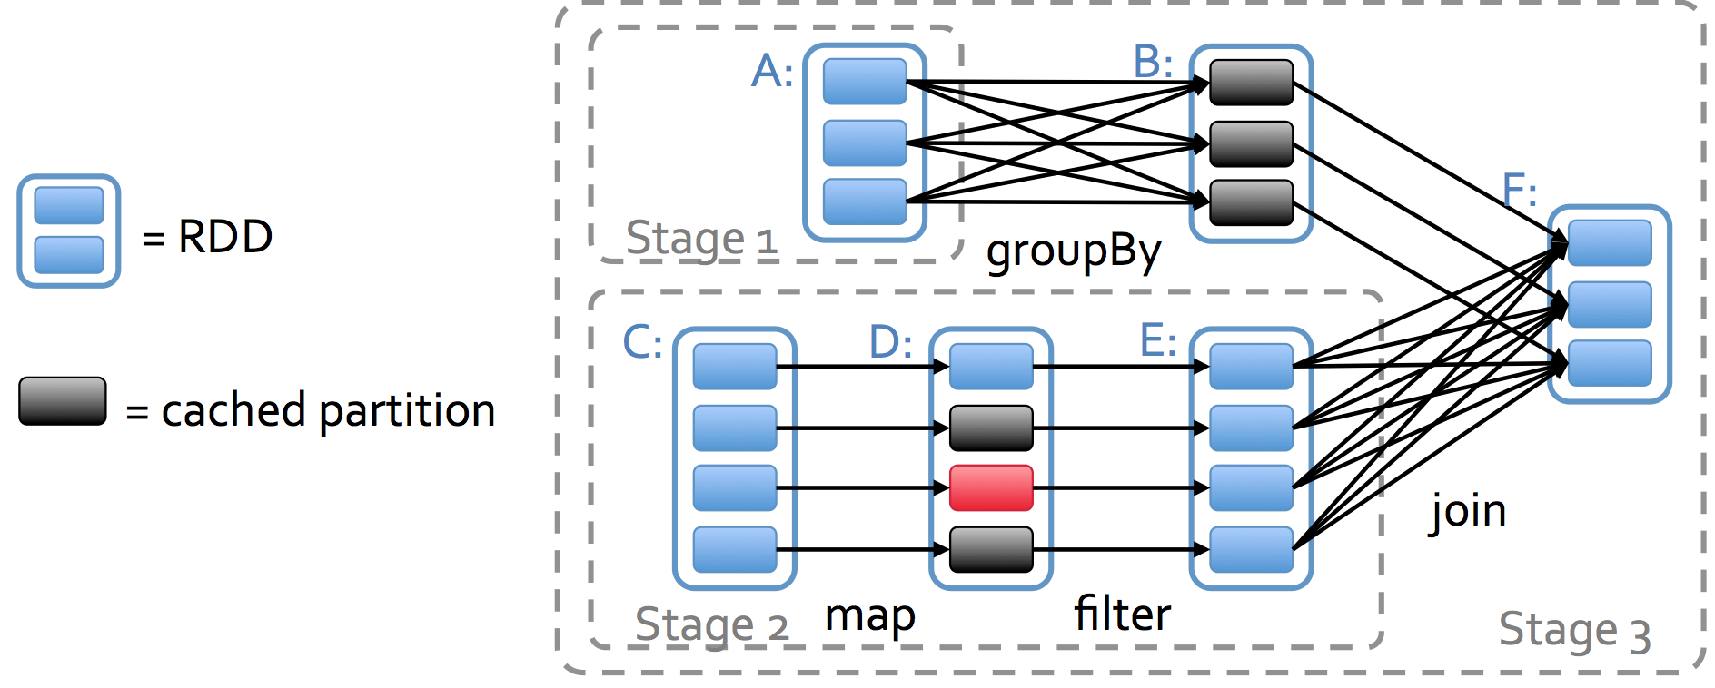
DAGs and Fault Tolerance
When an RDD partition is lost, re-compute the RDD partition only.

Slide 12
Agenda
Spark partitions and DAGS
Shuffle in Spark
Reuse of RDD

Slide 13
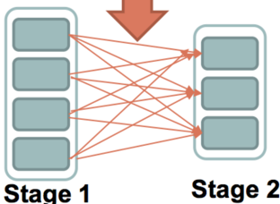
Data Shuffling
Data shuffling is one of the fundamental and frequent operations in Spark.
It generalizes MapReduce. A 2-stage job is exactly a MapReduce job.
Data shuffling is expensive.
Wait until all tasks in stage 1 finished
Each task in Stage 1 emits messages to each task in Stage 2. Messages are written to local file systems.
Each task in Stage 2 processes messages from Stage 1

Slide 14
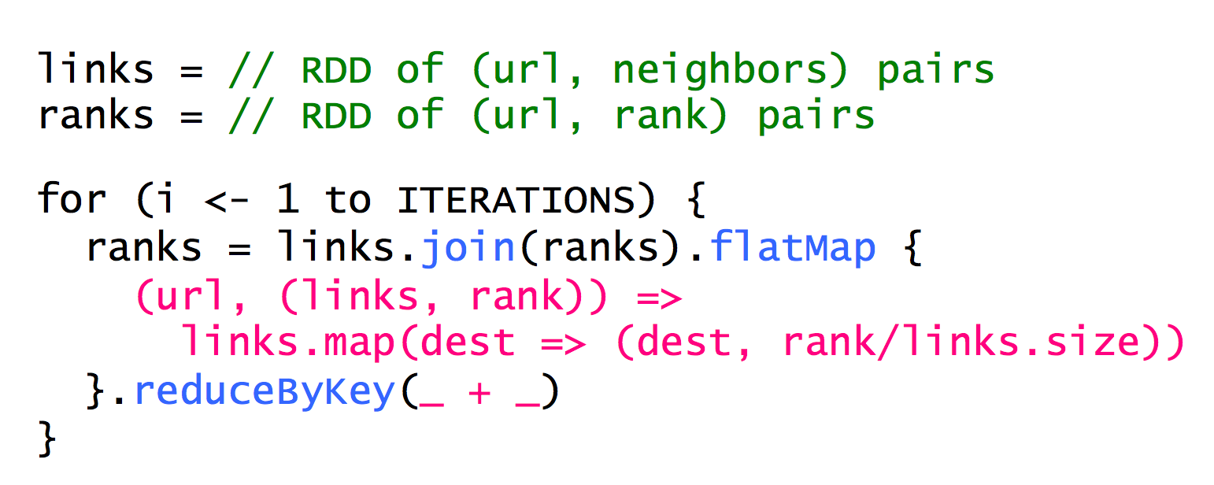
Data Partition Optimizations
Notes:
Map is a map in scala

Slide 15
Example
links (1, (2, 3)), (2,(3))
ranks (1, 0.33), (2, 0.33), (3, 0.33)
Links.join(ranks)
(1, ((2,3), 0.33)) (2, ((3), 0.33))
Map
(2, 0.33/2), (3, 0.33/2), (3, 0.33)
ReduceByKey
(2, 0.165), (3, 0.495)

Slide 16
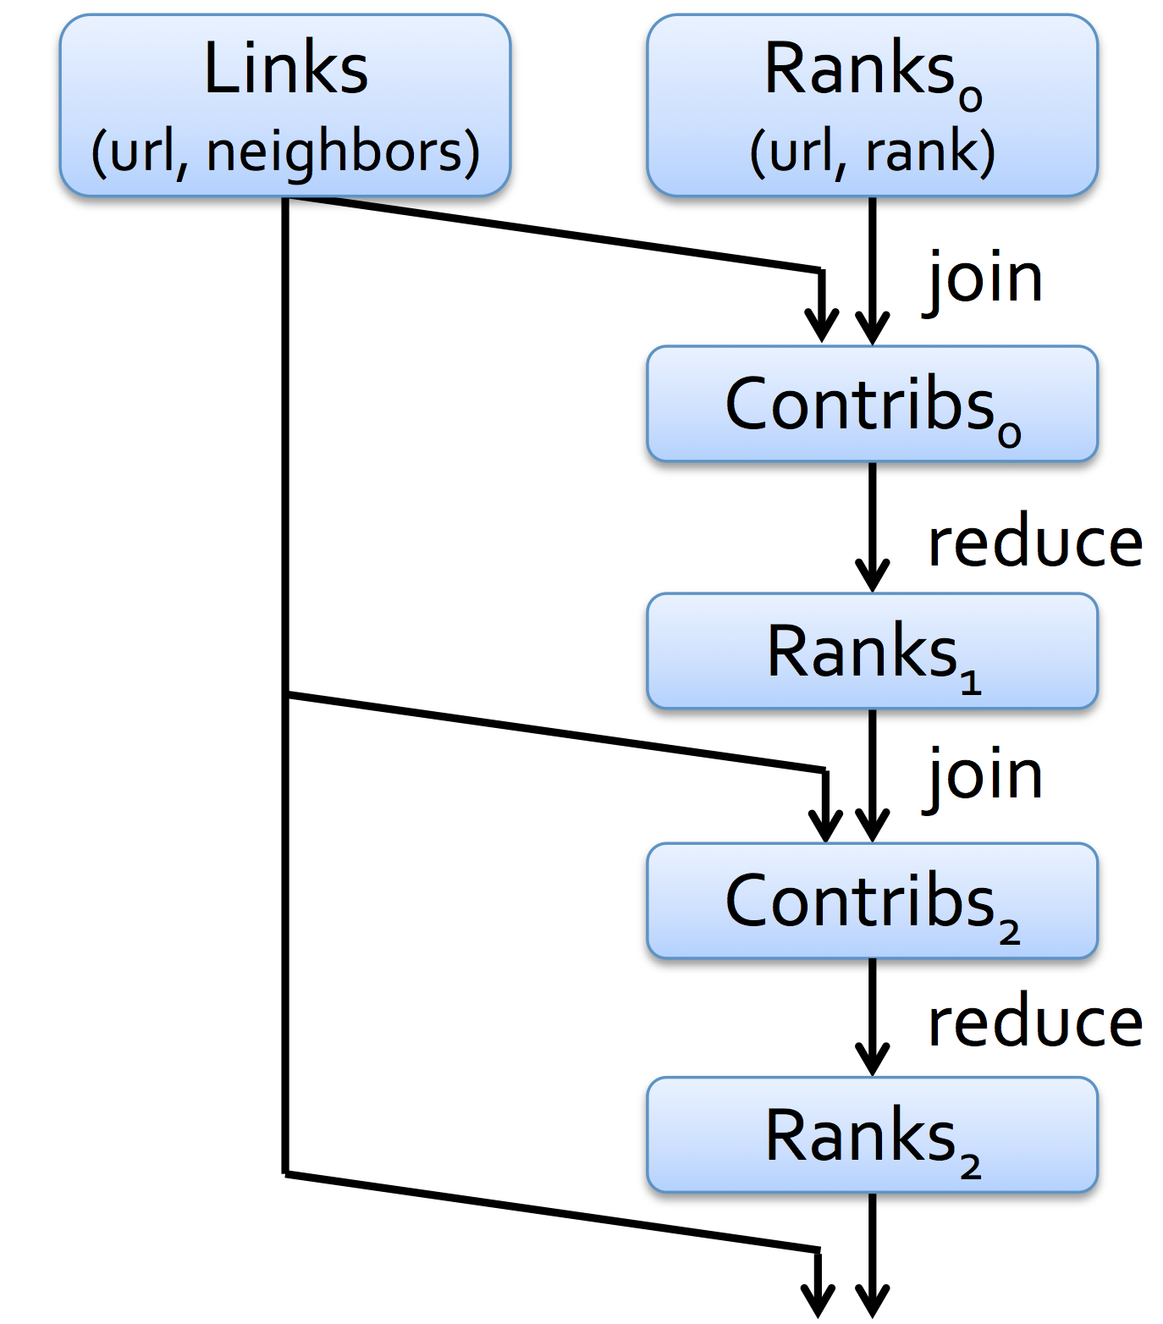
Eliminating Redundant Data Shuffling
Links and Ranks joins multiple times
Partition the links and ranks with sample url together would avoid unnecessary communications
partitionBy() are used to define how to partition data

Slide 17
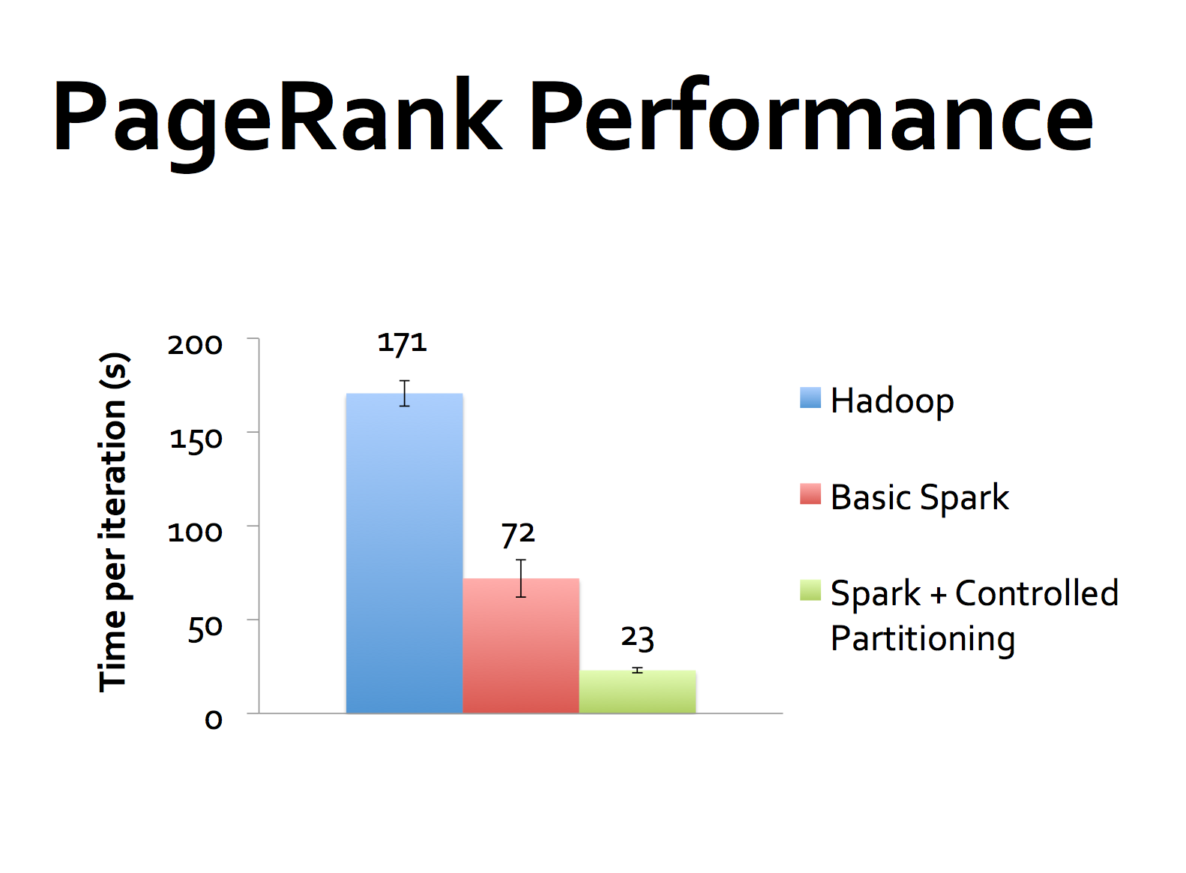

Slide 18
How Spark performs Data Shuffling
Currently Spark has implemented 4 methods
Hash Shuffle
Vanilla
ConsolidateFile
Sort Shuffle
Unsafe Shuffle

Slide 19
HashShuffle*
#file = #mapper * #reducer
https://0x0fff.com/spark-architecture-shuffle/
Notes:
10k mapper and 10k reducer = 100M files

Slide 20
Hash Shuffle - ConsolidateFile
#file = # of cores * #reducer( #reducer < 200)
Notes:
More mappers(tasks) than the number of cores for load balance, typical 2-4

Slide 21
SortShuffle – sort and merge
#file = #mapper, or more than that if spilled
Notes:
Each is sorted, but merged later

Slide 22
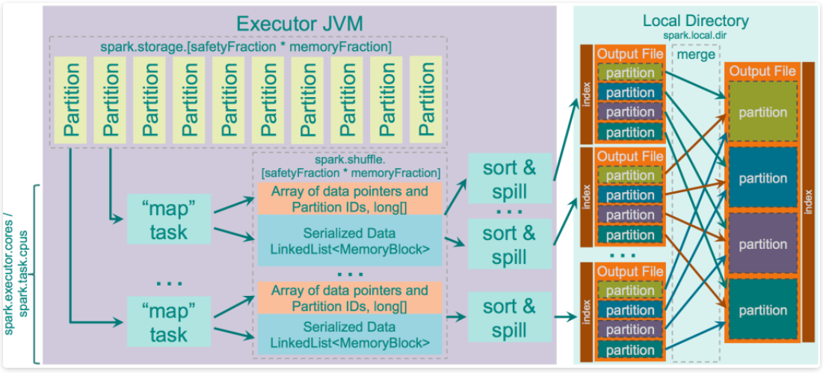
Unsafe Shuffle
sort elements in the form of raw byte arrays, thus more CPU-efficient

Slide 23
Data Shuffling Methods Summary
Hash Shuffle has the least CPU overhead, but its #partitions is limited.
Unsafe Shuffle almost has no #partitions limit but causes extra CPU overheads to sort.
Sort Shuffle sorts elements in Java-object-form, enabling map-side combining, but causes high CPU overhead.
 | Sort Order | #files | #partitions | combining? | overhead
Hash Shuffle | No Order | M * R | <200 | no | low
Sort Shuffle | Key Order | M | unlimited | yes | high
Unsafe Shuffle | Partition ID | M | <16M | no | med

Slide 24
Agenda
Spark partitions and DAGS
Shuffle in Spark
Reuse of RDD

Slide 25
How Spark keeps and reuses RDD?
RDDs can be kept in memory and reused in the future.
Avoid recalculation
Through ".cache()" or ".persist(…)" API call. "cache" is a special case for "persist"
lines = spark.textFile(“hdfs://...”)
errors = lines.filter(_.startsWith(“ERROR”))
messages = errors.map(_.split(‘\t’)(2))
cachedMsgs = messages.cache()
cachedMsgs.filter(_.contains(“bar”)).count

Slide 26
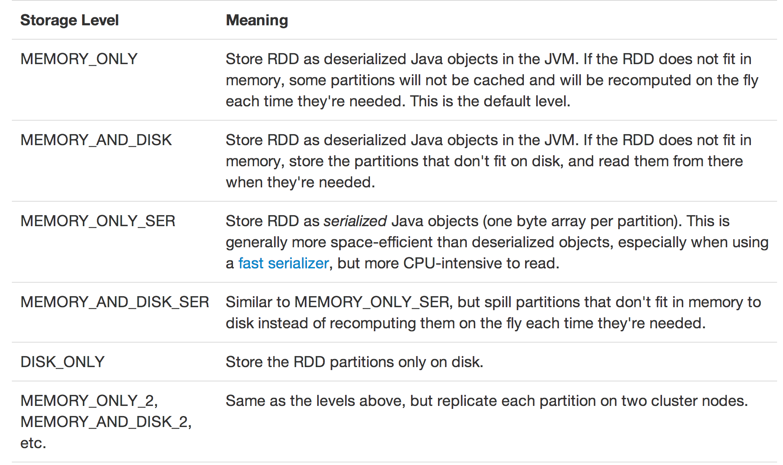

Slide 27
How Spark keeps and reuses RDD? (cont.)
Cached RDDs are distributedly stored in the block managers of executors.
Tasks depending on cached RDDs will be preferably scheduled to containing executors to avoid extra communication.
Missing partitions in a cached RDDs are OK. They will be re-evaluated according to the DAG.

Slide 28
Checkpointing
DAG would get too long, causing too much recovery overhead.
Cached RDDs are not reliable.
Call ".checkpoint()" to store RDDs in a reliable storage media, such as HDFS.
After checkpointing, the RDD's DAG will be replaced by "reading from HDFS".
…………………………

Slide 29
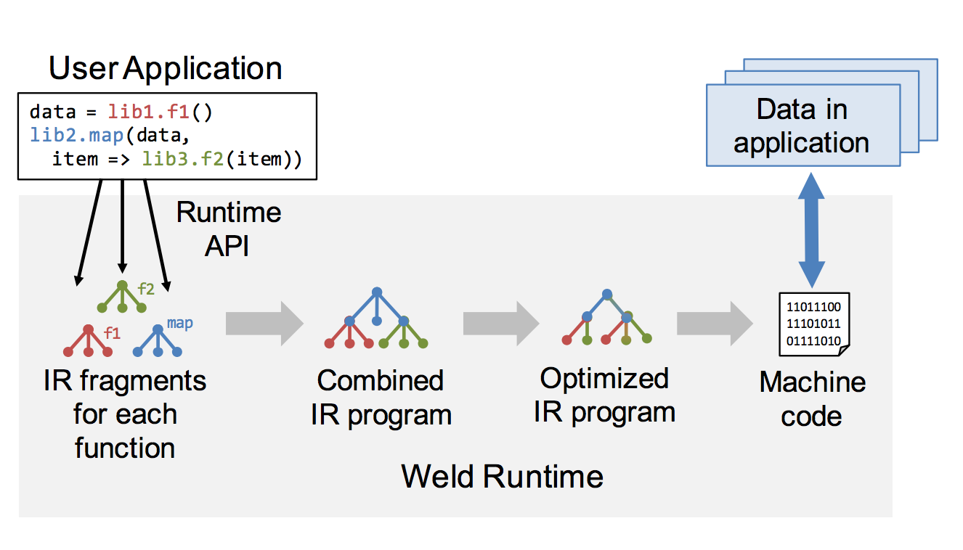
Weld*
Loop fusion
loop tiling
PRE
https://arxiv.org/pdf/1709.06416.pdf

Slide 30
Spark ecosystem

Slide 31
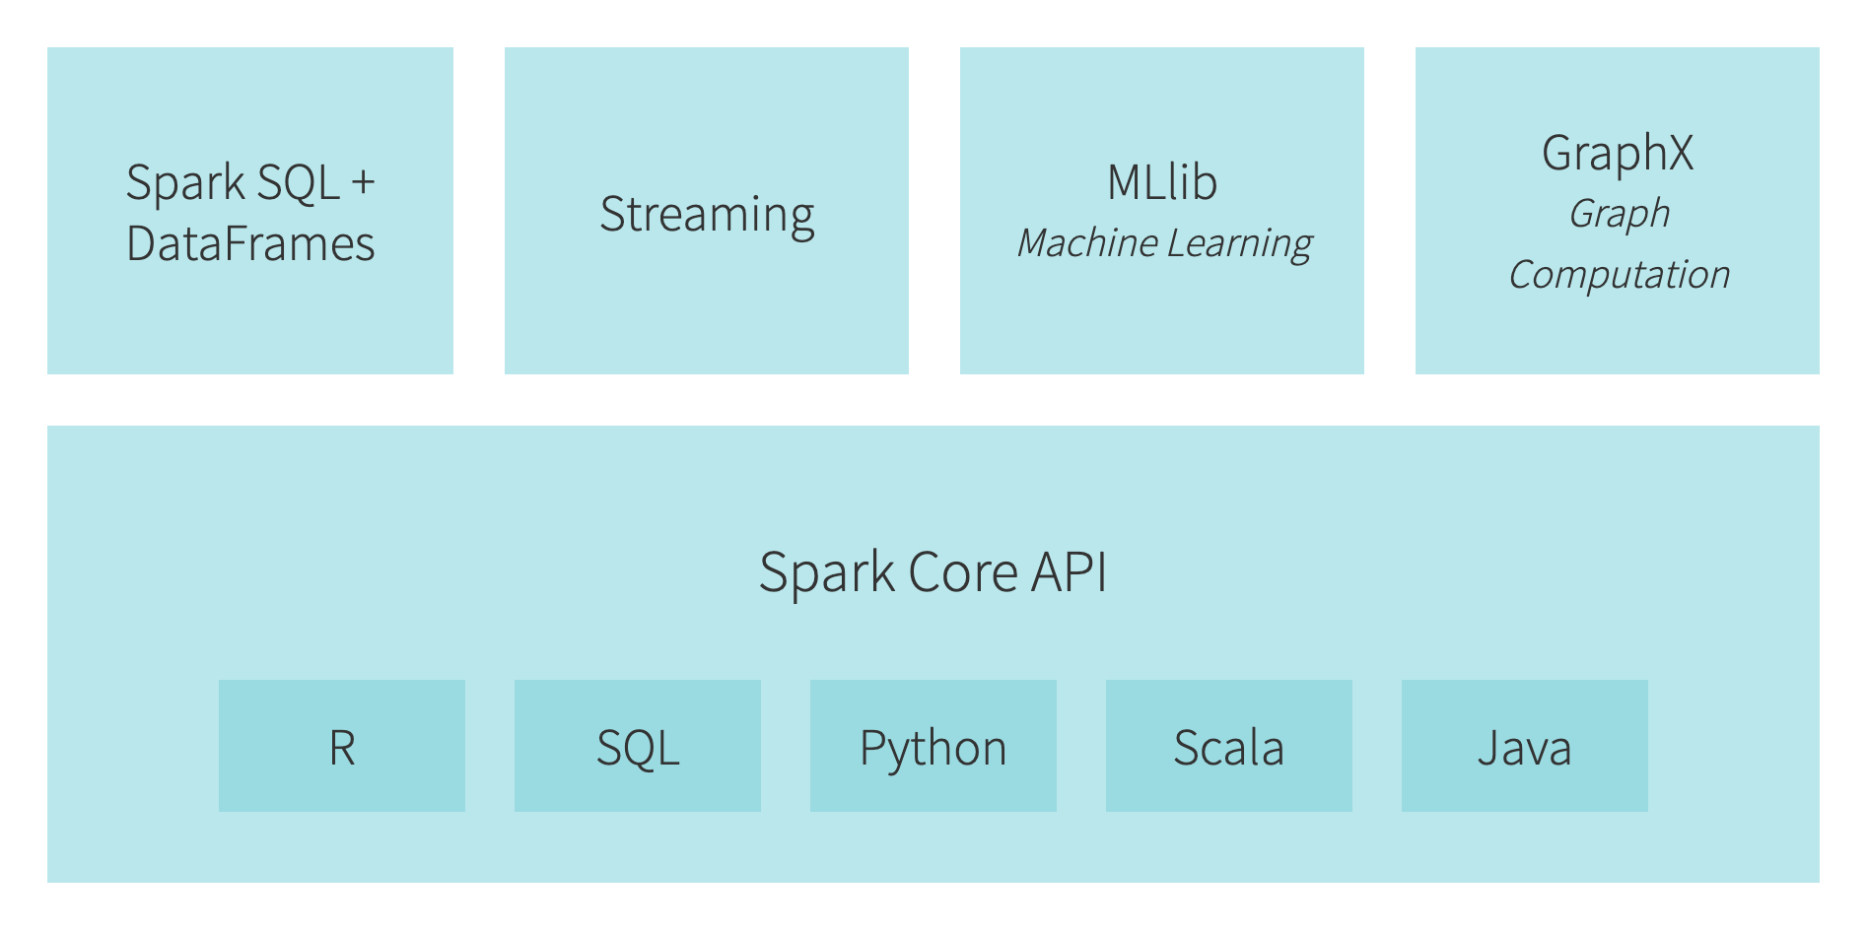
Notes:
Spark也可以集成在Hadoop环境中，通过Yarn进行调度

Slide 32
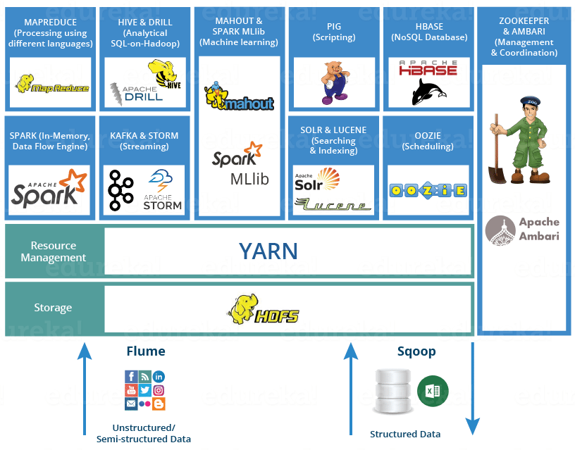

Slide 33
Existing Big data system
Giraph
Pregel
Dremel
Drill
Tez
MapReduce
Impala
GraphLab
Storm
…
S4
General systems for
Batch processing
Special system
(Iterative, interactive and streaming)

Slide 34
The methodology of Spark
Generalized MapReduce
Sharing the data and task DAGs
Unified Programming Framework
Shark
Streaming
GraphX
MLLib
…
Spark

Slide 35



Benefit of Using Spark
With different platforms
HDFS read
ETL
HDFS write
HDFS read
train
HDFS write
HDFS read
query
HDFS write
…
Spark:
Interactive analysis
HDFS read
ETL
train
query
HDFS

Slide 36
Limitations of Spark
Spark：RDD
BFS
Vertex Visited
.
.
.
RDD
Notes:
一个例子是图遍历，另一个是基于实时数据流的热词统计。右边这是Spark编程模型，这个方块代表数据集RDD，圆圈代表具体数据，对图遍历就是记录点的遍历进度的数据结构，对热词统计就是记录词频计数。
以图遍历为例，这个RDD保存着这些点遍历进度的数据结构，初始是0，遍历开始这个点变为1，需要更新，然后这两个点为2，这3个点为3，最后为4。
可以看到每次细粒度的数据更新，对于这种数据集读写的需求，由于spark基于粗粒度RDD只读的数据对象模型，需要RDD变换，即有大量数据的复制，导致处理效率不高。

Slide 37
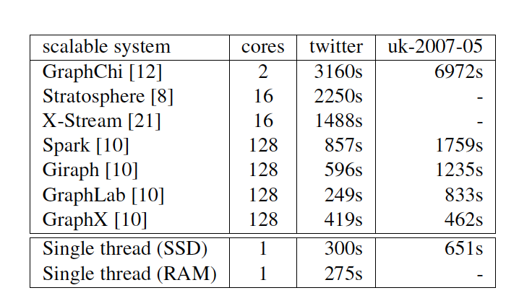
Spark is slow
In iterative algorithms, such as page rank, Spark is slower than 1 thread of rust program with 128 threads
*McSherry, Frank, Michael Isard, and Derek Gordon Murray. "Scalability! but at what COST?." HotOS. 2015.

Slide 38
Spark is memory in-efficient
Requires 20X raw data size
Sogou web graph is 137TB in raw size
Requires 2.7 PB memory to use with spark
**Zhu, Xiaowei, et al. "Gemini: A Computation-Centric Distributed Graph Processing System." OSDI. 2016.

Slide 39
Limitations of Spark
JVM based implementation
Memory size requirement(10X)
Garbage collection
Divide machines into many small containers
Each container contains 8-16GB memory
Out of memory error
Poor performance
Solutions
Specialized systems such as graph computing systems
Following lectures
Efficient general purpose big data processing systems

Slide 40
A Better Spark?

Slide 41
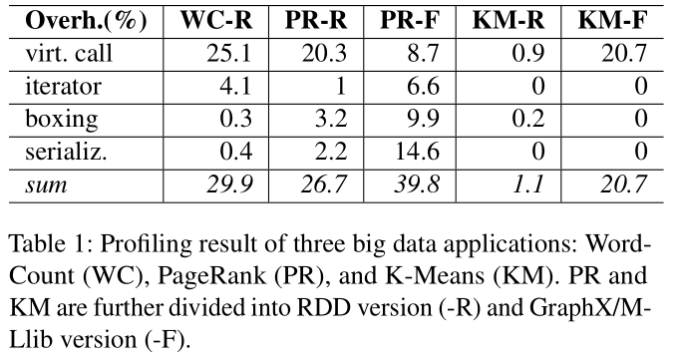
The overhead in Apache Spark’s design
Investigations reveal that abstraction overheads related to object-oriented programming (OOP) dominates Spark’s overhead.

Slide 42
What’s wrong with OOP? Is OOP abstraction to blame?
Spark’s high overhead is from a joint consequence of two systems’ designs:
Java: type erasure
Apache Spark: one-element-per-processing policy
Unlike C++, Java erases the type parameter to the top class "java.lang.Object". This requires primitive types to be wrapped in a box object, causing boxing overhead.
Spark calls the "next" method of an abstract iterator class for each element, causing virtual function call overhead.
class Tuple2<T1, T2>{
T1 _1;
T2 _2;
}
type erasure
class Tuple2 {
Object _1;
Object _2;
}
with type erasure
optimal form
edge ref
src ref
dst ref
src
dst
src
dst

Slide 43
Systems addressing Spark’s performance issue
New system from scratch in C++ (Husky, Thrill)
Toy system for proof-of-concept purpose: hard to deploy, missing functionalities, …
Abandon Spark ecosystem: cloud, deployed clusters, …
Offloading UDF to native (SparkJNI)
Data marshalling overhead between the managed world and the native world
Complicated to program and maintain
Higher abstraction level (Tungsten, Flare)
Restricted to certain application domains
Lack of general-purpose programming model

Slide 44
Idea: build native frameworks upon existing engines
Only Apache Spark’s low-efficiency computing module is replaced to high-efficiency native programming framework.
Assuming that communication, scheduling, fault-tolerance is not the bottleneck.
Reuse Apache Spark’s fault-tolerance, Mesos/YARN/Kubernetes integration, Spark shuffle service integration, security, metrics-based profiler, history server, Web UI, etc.
GraphX
MLLib
Fast Applications
Java API
Native API
Spark Core with RDD Abstraction
fault-tolerance, resource manager integration, shuffle service, security, profiler, …

Slide 45
Chukonu: A Fully-Featured High-Performance Big Data Framework that Integrates a Native Compute Engine into Spark^{[1]}
Providing easily-accessible C++ API (nearly identical to Spark API)
Familiar to Apache Spark users
Enabling bare-metal performance
Lower query latency
Saves computing resources
Integrating into Apache Spark with little overhead
Reuses Hadoop/Spark ecosystem
Reuses Spark’s production-grade functionalities
[1] Yu, Bowen, et al. "Chukonu: a fully-featured high-performance big data framework that integrates a native compute engine into Spark." Proceedings of the VLDB Endowment 15.4 (2021): 872-885.

Slide 46







Chukonu's workflow fits well with Spark
loadable modules
main.cpp
compatible to existing Spark environments
JNA
spark-submit
Chukonu runtime

Slide 47
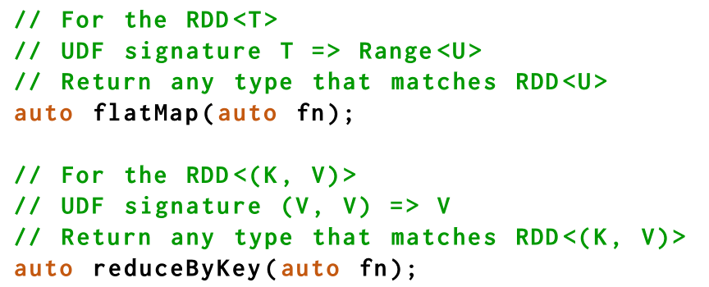
Chukonu C++ API
Chukonu
C++ API
Compute Engine
Runtime
Target Simplicity, Accessible (nearly identical to Spark API)
Employs modern C++ language features to enable zero-overhead abstraction, while hide the details from users.

Slide 48
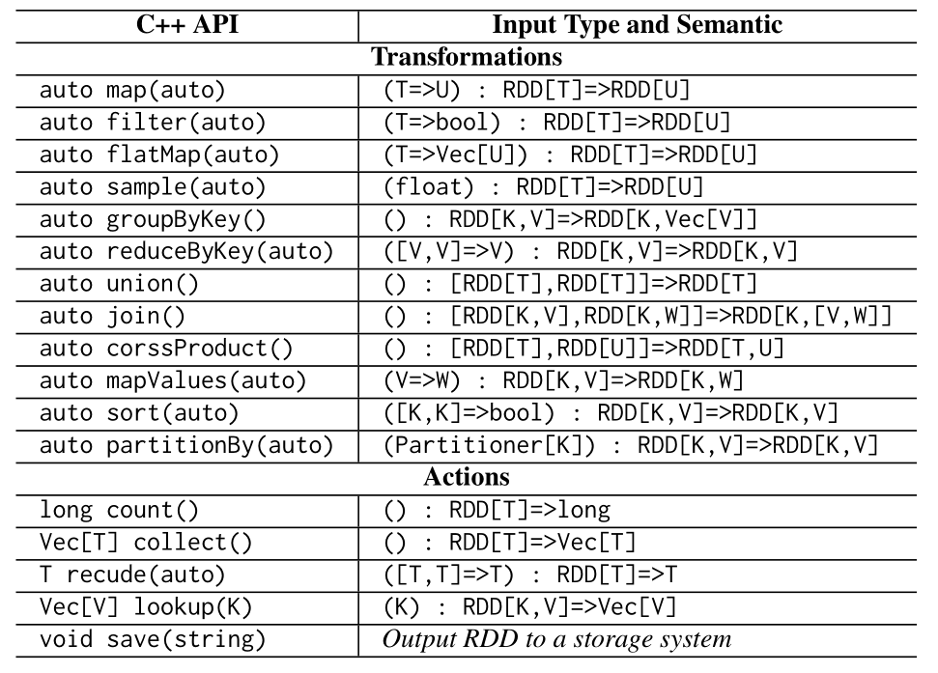

Slide 49
Example: Logistic Regression
Simplicity: 10 lines are enough (1 more line for the return statement)
Accessible: nearly line-to-line mapping between Spark API and Chukonu API

Slide 50
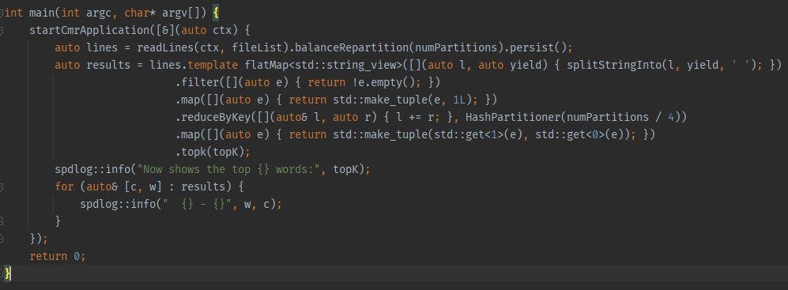
Concrete Example: Word Count
Chukonu
C++ API
Compute Engine
Runtime
Notes:
int main(int argc, char* argv[]) { startCmrApplication([&](auto ctx) { auto lines = readLines(ctx, fileList).balanceRepartition(numPartitions).persist(); auto results = lines.template flatMap<std::string_view>([](auto l, auto yield) { splitStringInto(l, yield, ' '); }) .filter([](auto e) { return !e.empty(); }) .map([](auto e) { return std::make_tuple(e, 1L); }) .reduceByKey([](auto& l, auto r) { l += r; }, HashPartitioner(numPartitions / 4)) .map([](auto e) { return std::make_tuple(std::get<1>(e), std::get<0>(e)); }) .topk(topK); spdlog::info("Now shows the top {} words:", topK); for (auto& [c, w] : results) { spdlog::info(" {} - {}", w, c); } }); return 0; }

Slide 51
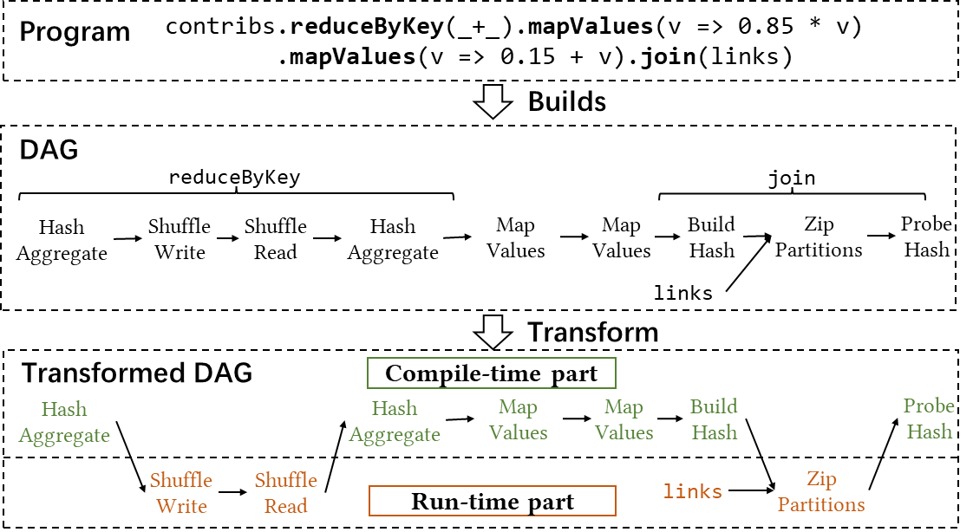
DAG transformation
Chukonu
C++ API
Compute Engine
Runtime
DAG transformation: splitting the DAG into two parts
Compile-time part: statically optimized via native compilation
Run-time part: dynamically executed by Spark runtime
processing elements
(“data plane”)
processing partitions
(“control plane”)

Slide 52
Challenges
Chukonu
C++ API
Compute Engine
Runtime
Interactions between JVM and Native code requires serialization/deserialization
Per-element processing in Spark makes naïve use of JNA very expensive

Slide 53
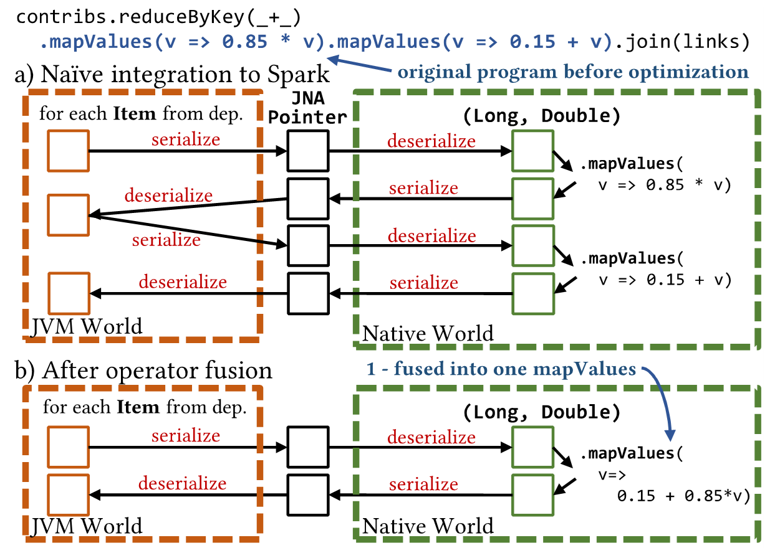
Optimization: Operator fusion
Chukonu
C++ API
Compute Engine
Runtime
Eliminate unnecessary memory materialization to save memory bandwidth

Slide 54
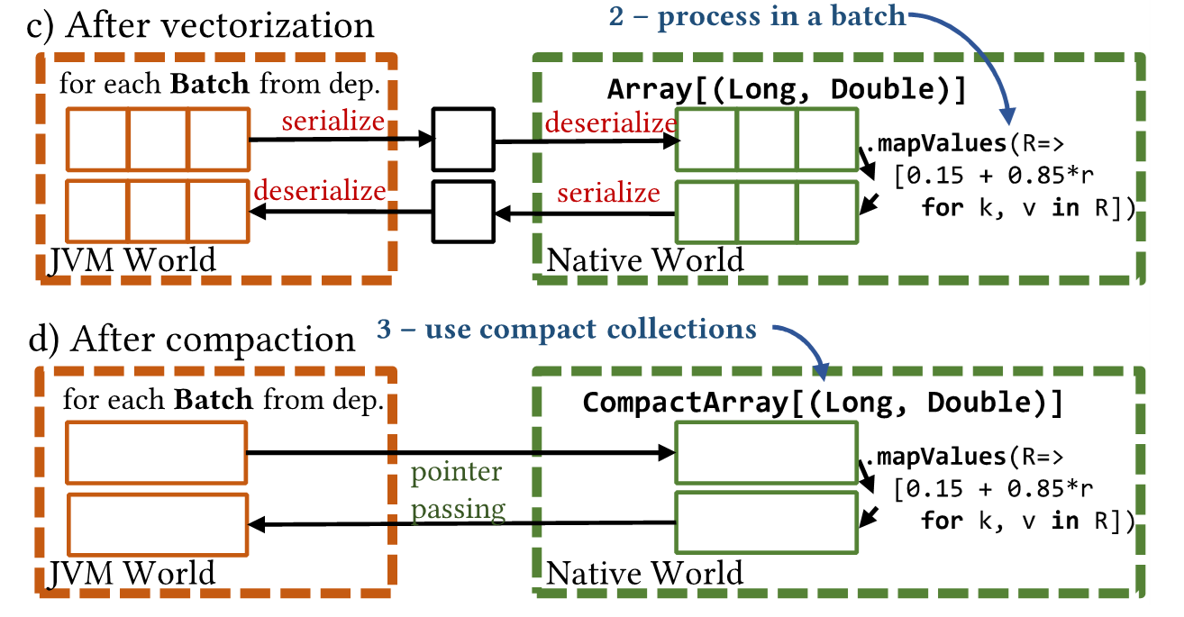
Optimization： Vectorization
Chukonu
C++ API
Compute Engine
Runtime
Batch small objects in a partition into a large object to eliminate abstraction overhead
Convert element-wise UDF to efficient partition-wise UDF via generic programming

Slide 55
Optimization： Compaction
Chukonu
C++ API
Compute Engine
Runtime
Generate serialization-bypassing compact data layout via generic programming
Reduce memory usage
Avoid serialization overhead

Slide 56
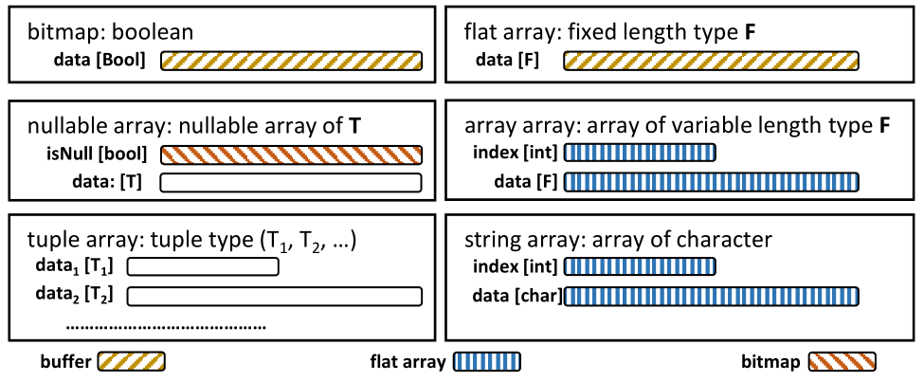
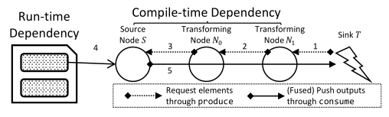

Slide 57
Runtime: Integration into Apache Spark
Chukonu
Target Low overhead
Relaxing JVM garbage collector
Relying on reference counting (e.g. std::shared_ptr) for automatic memory management
Pooling JNA buffer objects to reduce the number of Java object creation
Fast-path for data serialization
Compact data layouts returning buffers rather than writing into an I/O stream for performance
Data source acceleration
Accelerating line-splitting for text files and column-to-row conversion for Parquet files via native compilation
Runtime
C++ API
Compute Engine

Slide 58
Evaluation
Configurations
8 node, each with 2 CPU * 14 Core * 2 Thread (E5-2680 v4), 256GB DRAM, 6TB NVMe SSD, 100Gbps IB EDR
Baselines
Spark: Spark's RDD API
Spark Framework: MLlib / GraphX / GraphFrame / SparkSQL
Pure-native Framework: Thrill / Husky
Chukonu: Chukonu's RDD API

Slide 59
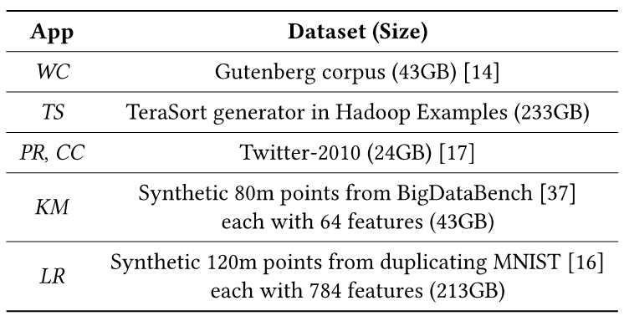
Applications and Dataset
Unstructured Data Processing
WC: Word count
TS: Tera-sort
Graph Computing
PR: Page-rank
CC: (Weakly-)connected component
Machine Learning
KM: K-Means
LR: Logistic regression

Slide 60
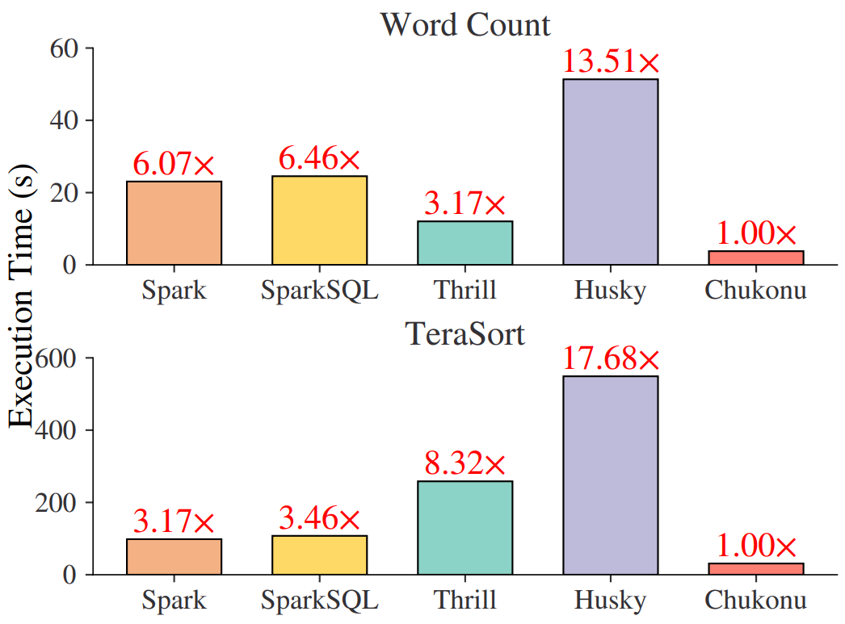
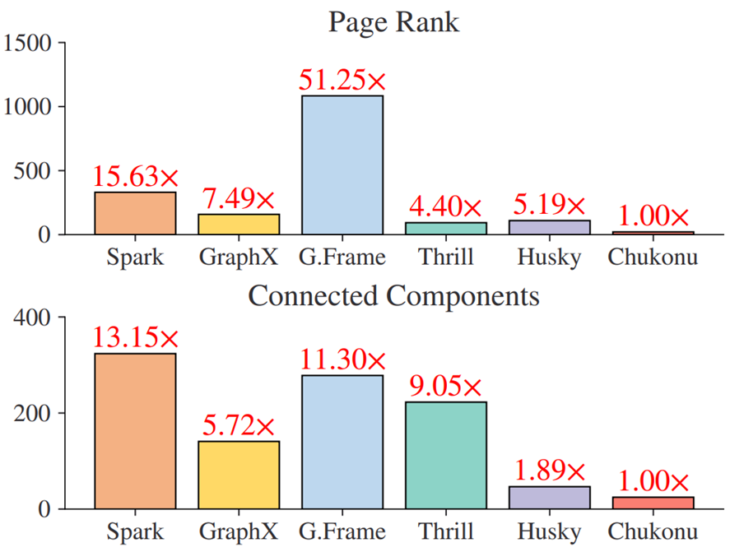
Evaluation – Performance
Chukonu is faster than all the other baselines
Compared with Spark: 12.65x speed-up
Compared with Thrill: 4.86x speed-up
Compared with Husky: 5.91x speed-up
3-6X vs Spark on unstructured
13-15X vs Spark on graph algorithms

Slide 61
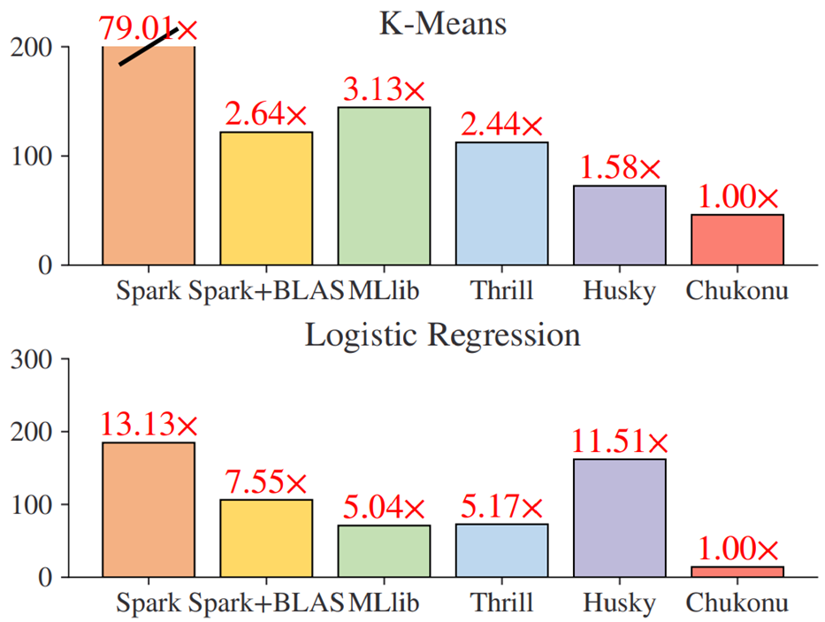
Evaluation – Performance (cont.)
Chukonu is faster than all the other baselines
Compared with Spark: 12.65x speed-up
Compared with Thrill: 4.86x speed-up
Compared with Husky: 5.91x speed-up
13-79X vs Spark on machine learning
3-5X vs MLlib

Slide 62
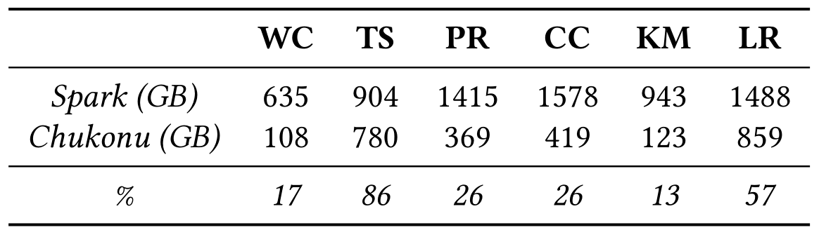
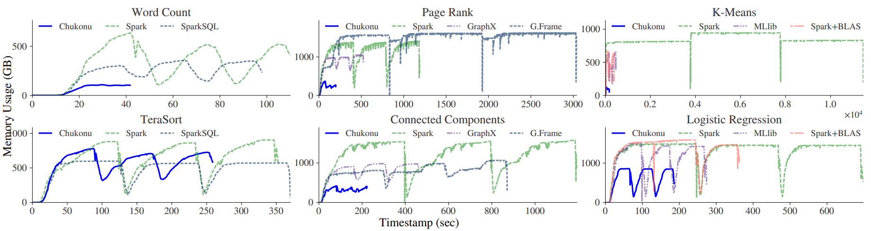
Evaluation – Memory Usages
30% memory consumption of Spark

Slide 63
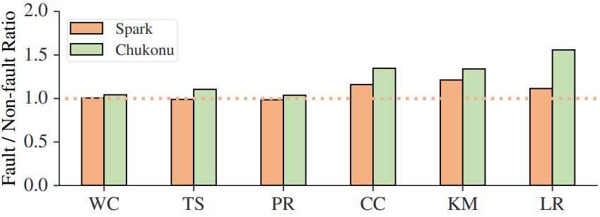
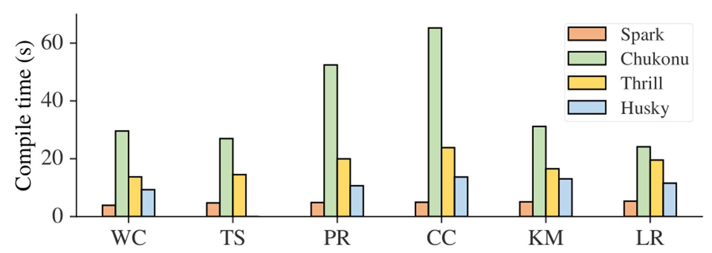
Failure Recovery and Compile time
Failure recovery
Inherit Spark’s fault tolerance capability
Compile time
Long compile time due to the C++ template
Not good for ad-hoc interactive queries yet.

Slide 64
Thanks!

